Slide 1
Introduction & Overview

Slide 2
Books
Text Book:
  Operating System Concepts, n^{th} Editon, Silberschatz Galvin Gagne
Reference Books:
  Modern Operating Systems, 2nd Edition, Andrew S. Tanenbaum
  Operating Systems, (7/8)^{th} Edition, William Stallings
23-Jan-24
Operating Systems -

Slide 3
General Info
Muhammad.amin@nu.edu.pk
Room 24
Office Hours
  Monday, Wednesday
    1400 to 1500 hrs
Plagiarism
Discussion
23-Jan-24
Operating Systems -

Slide 4
“Tentative” Grading
Assignments 05%
Project 10%
Quizzes 05%
Midterm I 15%
Midterm II 15%
Final Exam 50%
23-Jan-24
Operating Systems -

Slide 5
Why OS?
Eyes Wide Open
  21st century
  digital divide / cut throat / cutting edge
  Security hazards – virus, DoS, worms
Digitally Compact Models
  Radio, clock, pager, ipod, tv, wireless, telephone, camera, webcam, organizer, audio-video player
  Remotes (ac, tv, fan, gates, security system, etc)
Interfacing
  Mobile (windows mobile), any machinery for that matter
23-Jan-24
Operating Systems -

Slide 6
What is an Operating System?
It is a program!
Top-down view
  Provides an extended or virtual machine abstraction to user programs
    Easier to program than the underlying hardware.
    All services are invoked and accomplished through system calls.
Bottom-up view
  Acts as a resource manager of a complex system
  Resources consist of processors, memories, timers, disks, keyboard, network interfaces, printers etc.
  OS manages allocation of these resources to user programs in an orderly and controlled manner
23-Jan-24
Operating Systems -

Slide 7
What is an Operating System?
OS do nothing by themselves.
Similar to subroutine libraries, do nothing unless they are invoked by programs
Act as an intermediary between users and the hardware
23-Jan-24
Operating Systems -

Slide 8
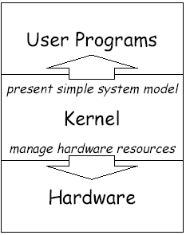
Two Goals of Operating Systems
Manage hardware resources
  System operates smoothly: efficiently, reliably, securely
Present abstract system model to programmer
  Simple and convenient access to and control of resources
23-Jan-24
Operating Systems -

Slide 9
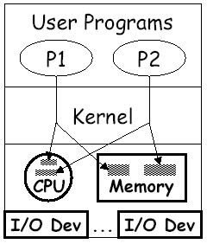
Manager/Coordinator of Resources
Coordinates who gets what
  “who”: running programs
  “what”: resources
  “when”: scheduling time
  “where”: organizing space
  “whether”: limits, rights
Goal: smooth system operation
  efficiency, reliability, security
23-Jan-24
Operating Systems -

Slide 10
Resource multiplexing
OS multiplexes resources in two ways:
  Time multiplexing
    involves different programs taking turns in using the resource.
    e.g CPU scheduling, printer sharing
  Space multiplexing
    involves different program getting part of the resource possibly at the same time.
    e.g. memory is divided into several running programs
23-Jan-24
Operating Systems -

Slide 11
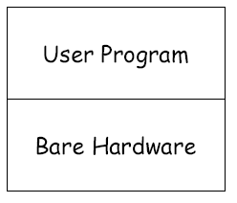
What If No Operating System?
All we have is bare hardware
You want to run a program
  How do you load it?
  How do you run it?
  What happens when it completes?
Need at least some minimal OS to do these functions
23-Jan-24
Operating Systems -

Slide 12
…Lets go back to the “stone age” of computing…

Slide 13
Early Systems
No Operating systems,
your Data and your Programs
  X = X + 1;
As
  Load Register1, x
  Load Direct Register2, 1
  Add Register3, Register2, Register1
  Store Register3, x
Time slots allocated to scientists
Enter programs using binary switches
Input became efficient: Punch card, tape drives
  Control cards: Use of hardware
  Program
  Data
23-Jan-24
Operating Systems -

Slide 14
Early Systems
Problem:
  computer idles while programmer sets things up.
  Poor utilization of huge investment.
Solution:
  Hire a specialized person to do setup.
Problem:
  Faster than programmer, but still a lot slower than the machine.
Solution:
  Build a batch monitor.
23-Jan-24
Operating Systems -

Slide 15

The Monitor
Early batch system
  bring cards to 1401
  read cards to tape
  put tape on 7094 which does computing
  put tape on 1401 which prints output
23-Jan-24
Operating Systems -

Slide 16
Simple Batch System
The user submits a job (written on a card or tape) to a computer operator.
The computer operator place a batch of several jobs on a input device
A special program, the monitor, manages the execution of each program in the batch
Resident monitor is in the main memory and available for execution
23-Jan-24
Operating Systems -

Slide 17
The Monitor
Monitor reads job one at a time from the input device
Monitor places a job in the user program area
A monitor instruction branches to the start of the user program
Execution of the user program continues until:
  End of program occurs
  Error occurs
23-Jan-24
Operating Systems -

Slide 18
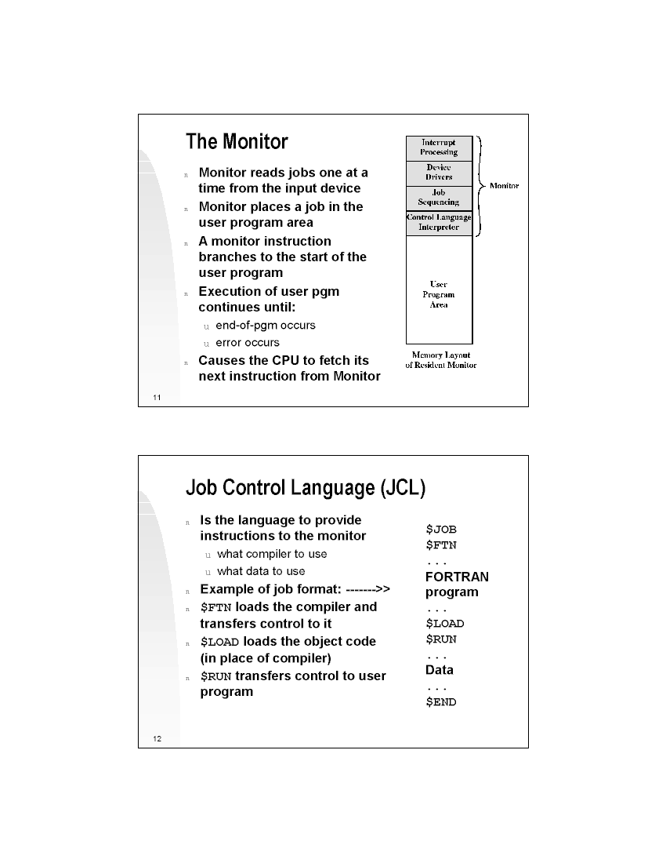
The Monitor
Managed the I/O devices
Speeded up the time between two jobs
Issues raised:
  Monitor’s memory should be protected
  A bug in the program should not crash the monitor.
23-Jan-24
Operating Systems -

Slide 19
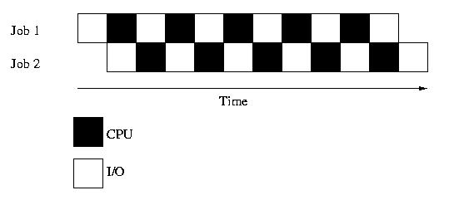
Multiprogramming
Execute multiple jobs simultaneously
But a CPU can execute a single instruction at a time?
One job can use the CPU while the other is waiting for I/O
Small jobs not delayed by large jobs
Overhead?
Context switching
23-Jan-24
Operating Systems -

Slide 20
Requirements for Multiprogramming
What else?
Hardware support:
  I/O interrupts and (possibly) DMA
    OS requests I/O, goes back to computing, gets interrupt when I/O device finishes
  Memory management
    several ready-to-run jobs must be kept in memory
    Memory protection (data and programs)
Software support from the OS:
  Job Scheduling
    which ready jobs should be brought to memory
  CPU Scheduling
    which program is to be run next
  To manage resource contention
23-Jan-24
Operating Systems -

Slide 21
Multiprogramming
What is the Performance criteria?
Turn-Around Time
  the length of time between the start of the job and when the output was done.
23-Jan-24
Operating Systems -

Slide 22
Time Sharing System (TSS)
Processor’s time is shared among multiple users
Use cheap terminals to let multiple users interact with the system at the same time.
OS does timesharing to give illusion of each user has own computer
User can interact during the execution time
Plus Multiple jobs can be run
User can
  Interact and React
  Control the path of the program
  Perform interactive debugging
23-Jan-24
Operating Systems -

Slide 23
Time Sharing System (TSS)
Time sharing was achieved by resource sharing???
  e.g., the CPU among the jobs
Performance measured in terms of Response Time
  the length of time between the start of a job and the first output.
Utilization is still a problem. Why?
CPU time sacrificed to get better response time for users
CPU still has to wait, while a slower user is entering data on key board.
Other jobs must run during this time.
23-Jan-24
Operating Systems -

Slide 24
Personal Computing
Computers are cheap, so give everyone a computer.
Initially, OS became a subroutine library again (MSDos)
Since then, adding back in memory protection, multiprogramming, etc.
Because when humans are expensive, don’t waste their time by letting programs crash each other.
23-Jan-24
Operating Systems -

Slide 25
Distributed Computing
Computers so cheap – give people a bunch of them
  I have a PC at home, 2 in my office, 2 Cell phones, a palm device and share some machines in a lab how do I coordinate a bunch of machines?
Networks fast – allow machines to share resources and data easily
Networks cheap – allow geographically distributed machines to interact
23-Jan-24
Operating Systems -

Slide 26
Caution!!!
Point of describing change isn’t “Look how stupid batch processing is” – it was right for tradeoffs of the time, but not anymore
Point is: have to change with changing technology
Situation today is much like it was in the late 60’s OS’s today are enormous, complex things
  100k's of lines (or >1M lines)
  Windows NT is 20M lines
  Windows2000 and Windows XP are about 40M lines.
Key aspect of this course, understand OS’s so we can simplify them!
23-Jan-24
Operating Systems -

